Slide 1

Chapter 2
Application Layer
A note on the use of these PowerPoint slides:
We’re making these slides freely available to all (faculty, students, readers). They’re in PowerPoint form so you see the animations; and can add, modify, and delete slides (including this one) and slide content to suit your needs. They obviously represent a lot of work on our part. In return for use, we only ask the following:
If you use these slides (e.g., in a class) that you mention their source (after all, we’d like people to use our book!)
If you post any slides on a www site, that you note that they are adapted from (or perhaps identical to) our slides, and note our copyright of this material.
For a revision history, see the slide note for this page.
Thanks and enjoy! JFK/KWR
All material copyright 1996-2020
J.F Kurose and K.W. Ross, All Rights Reserved
Computer Networking: A Top-Down Approach
8th edition n
Jim Kurose, Keith Ross
Pearson, 2020
Notes:
Version History
8.0 (April 2020)
All slides reformatted for 16:9 aspect ratio
All slides updated to 8th edition material
Use of Calibri font, rather that Gill Sans MT
Add LOTS more animation throughout

Slide 2

Application layer: overview
P2P applications
video streaming and content distribution networks
socket programming with UDP and TCP (Syllabus not covered)
Principles of network applications
Web and HTTP
E-mail, SMTP, IMAP
The Domain Name System DNS

Slide 3
Application layer: overview
Our goals:
conceptual and implementation aspects of application-layer protocols
  transport-layer service models
  client-server paradigm
  peer-to-peer paradigm
  content distribution networks
learn about protocols by examining popular application-layer protocols
  HTTP
  FTP
  SMTP, IMAP, POP3
  DNS
programming network applications
  socket API

Slide 4
Some network apps
social networking
Web
text messaging
e-mail
multi-user network games
streaming stored video (YouTube, Hulu, Netflix)
P2P file sharing
voice over IP (e.g., Skype)
real-time video conferencing
Internet search
remote login
…

Slide 5

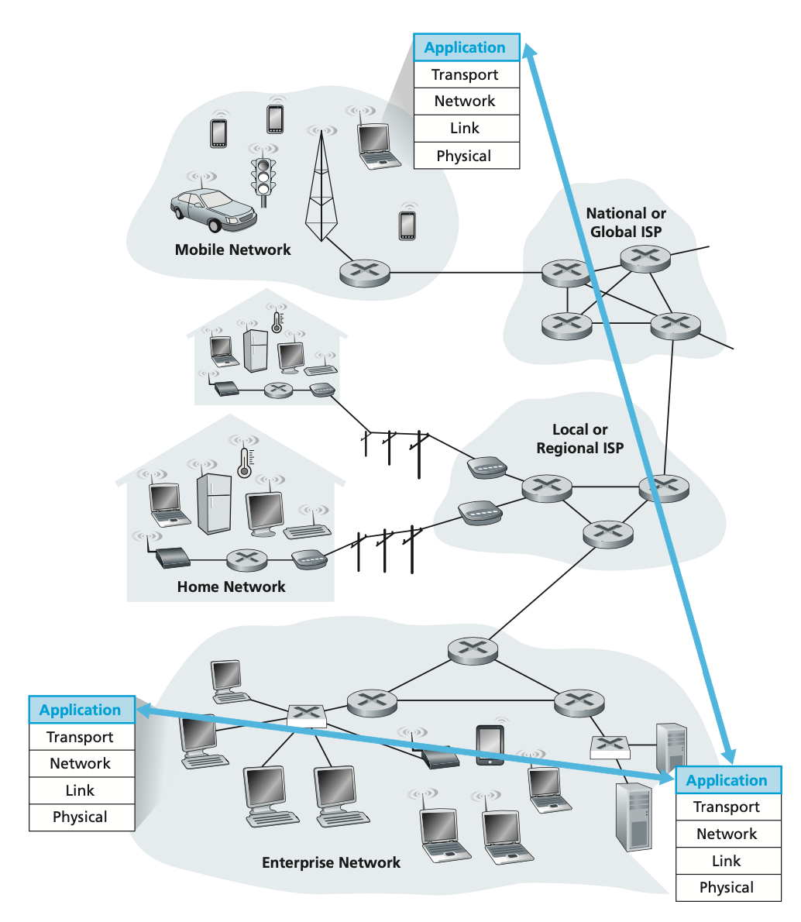
Confining application software to the end systems

Slide 6
















Creating a network app
application
transport
network
data link
physical
write programs that:
run on (different) end systems
communicate over network
e.g., web server software communicates with browser software
no need to write software for network-core devices
network-core devices do not run user applications
applications on end systems allows for rapid app development, propagation
mobile network
national or global ISP
local or regional ISP
home network
content
provider
network
application
transport
network
data link
physical
application
transport
network
data link
physical
datacenter
network
enterprise
network

Slide 7
Application architecture/paradigm
possible structure of architectures/paradigms:
client-server
peer-to-peer (P2P)

Slide 8
Client-server architecture/paradigm
server:
always-on host
permanent IP address
often in data centers, for scaling
clients:
contact, communicate with server
may be intermittently connected
may have dynamic IP addresses
do not communicate directly with each other
examples: HTTP, IMAP, FTP
mobile network
national or global ISP
local or regional ISP
home network
content
provider
network
datacenter
network
enterprise
network
Notes:
In a client-server architecture, there is an always-on host, called the server, which services requests from many other hosts, called clients. A classic example is the Web application for which an always-on Web server services requests from browsers running on client hosts. When a Web server receives a request for an object from a client host, it responds by sending the requested object to the client host. Note that with the client-server architecture, clients do not directly communicate with each other; for example, in the Web application, two browsers do not directly communicate. Another characteristic of the client-server architecture is that the server has a fixed, well-known address, called an IP address (which we’ll discuss soon). Because the server has a fixed, well-known address, and because the server is always on, a client can always contact the server by sending a packet to the server’s IP address. Some of the better-known applications with a client-server architecture include the Web, FTP, Telnet, and e-mail

Slide 9



Client-server architecture/paradigm
Data center:
housing a large number of hosts
create a powerful virtual server
popular Internet services employ one or more data centers
A data center can have hundreds of thousands of servers
Search engine
Internet
e-commerce
Social
networking
Notes:
In a client-server architecture, there is an always-on host, called the server, which services requests from many other hosts, called clients. A classic example is the Web application for which an always-on Web server services requests from browsers running on client hosts. When a Web server receives a request for an object from a client host, it responds by sending the requested object to the client host. Note that with the client-server architecture, clients do not directly communicate with each other; for example, in the Web application, two browsers do not directly communicate. Another characteristic of the client-server architecture is that the server has a fixed, well-known address, called an IP address (which we’ll discuss soon). Because the server has a fixed, well-known address, and because the server is always on, a client can always contact the server by sending a packet to the server’s IP address. Some of the better-known applications with a client-server architecture include the Web, FTP, Telnet, and e-mail
Often in a client-server application, a single-server host is incapable of keep- ing up with all the requests from clients. For example, a popular social-networking site can quickly become overwhelmed if it has only one server handling all of its requests. For this reason, a data center, housing a large number of hosts, is often used to create a powerful virtual server. The most popular Internet services—such as search engines (e.g., Google, Bing, Baidu), Internet commerce (e.g., Amazon, eBay, Alibaba), Web-based e-mail (e.g., Gmail and Yahoo Mail), social networking (e.g., Facebook, Instagram, Twitter, and WeChat)—employ one or more data centers.
Google has 30 to 50 data centers distributed around the world, which collectively handle search, YouTube, Gmail, and other services. A data center can have hundreds of thousands of servers, which must be powered and maintained. Additionally, the service providers must pay recurring interconnection and bandwidth costs for sending data from their data centers.

Slide 10
Peer-peer architecture/paradigm
no always-on server
arbitrary end systems directly communicate
peers request service from other peers, provide service in return to other peers
  self scalability – new peers bring new service capacity, as well as new service demands
peers are intermittently connected and change IP addresses
  complex management
example: P2P file sharing
mobile network
national or global ISP
local or regional ISP
home network
content
provider
network
datacenter
network
enterprise
network
Notes:
In a P2P architecture, there is minimal (or no) reliance on dedicated servers in data centers. Instead the application exploits direct communication between pairs of intermittently connected hosts, called peers. The peers are not owned by the service provider, but are instead desktops and laptops controlled by users, with most of the peers residing in homes, universities, and offices. Because the peers communicate without passing through a dedicated server, the architecture is called peer-to-peer. Many of today’s most popular and traffic-intensive applications are based on P2P architectures. These applications include file sharing (e.g., BitTorrent), peer-assisted download acceleration (e.g., Xunlei), and Internet telephony and video conference (e.g., Skype).
Often in a client-server application, a single-server host is incapable of keep- ing up with all the requests from clients. For example, a popular social-networking site can quickly become overwhelmed if it has only one server handling all of its requests. For this reason, a data center, housing a large number of hosts, is often used to create a powerful virtual server. The most popular Internet services—such as search engines (e.g., Google, Bing, Baidu), Internet commerce (e.g., Amazon, eBay, Alibaba), Web-based e-mail (e.g., Gmail and Yahoo Mail), social networking (e.g., Facebook, Instagram, Twitter, and WeChat)—employ one or more data centers. As discussed in Section 1.3.3, Google has 30 to 50 data centers distributed around the world, which collectively handle search, YouTube, Gmail, and other services. A data center can have hundreds of thousands of servers, which must be powered and maintained. Additionally, the service providers must pay recurring interconnection and bandwidth costs for sending data from their data centers.

Slide 11
Processes communicating
process: program running within a host
within same host, two processes communicate using inter-process communication (defined by OS)
processes in different hosts communicate by exchanging messages
clients, servers
client process: process that initiates communication
server process: process that waits to be contacted
note: applications with P2P architectures have client processes & server processes
Notes:
Processes on two different end systems communicate with each other by exchanging messages across the computer network. A sending process creates and sends messages into the network; a receiving process receives these messages and possibly responds by sending messages back.
in the Web application a client browser process exchanges messages with a Web server process. In a P2P file-sharing system, a file is transferred from a process in one peer to a process in another peer. For each pair of communicating processes, we typically label one of the two processes as the client and the other process as the server. With the Web, a browser is a client process and a Web server is a server process. With P2P file sharing, the peer that is downloading the file is labeled as the client, and the peer that is uploading the file is labeled as the server.

Slide 12

Sockets
process sends/receives messages to/from its socket
socket analogous to door
  sending process shoves message out door
  sending process relies on transport infrastructure on other side of door to deliver message to socket at receiving process
  two sockets involved: one on each side
application
socket
application
controlled by
app developer
process
process
transport
transport
network
network
controlled
by OS
link
Internet
link
physical
physical
Notes:
A process sends messages into, and receives messages from, the network through a software interface called a socket.

Slide 13
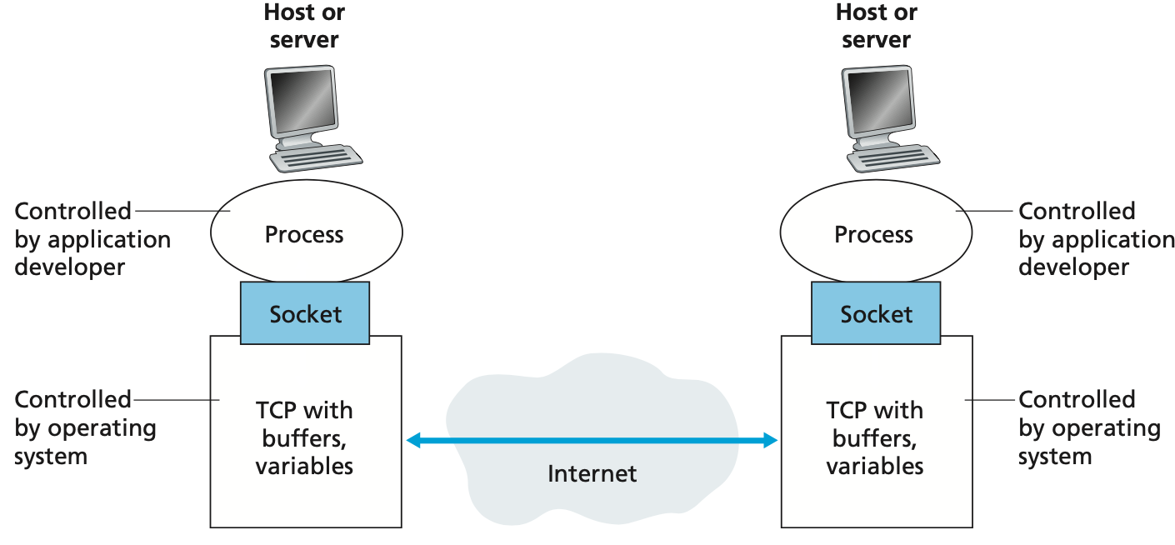
Application processes, sockets, and underlying transport protocol
Notes:
A process sends messages into, and receives messages from, the network through a software interface called a socket.

Slide 14
Addressing processes
to receive messages, process must have identifier
host device has unique 32-bit IP address
Q: does IP address of host on which process runs suffice for identifying the process?
identifier includes both IP address and port numbers associated with process on host.
example port numbers:
  HTTP server: 80
  mail server: 25
to send HTTP message to gaia.cs.umass.edu web server:
  IP address: 128.119.245.12
  port number: 80
more shortly…
  A: no, many processes can be running on same host
Notes:
In the Internet, the host is identified by its IP address. We’ll discuss IP addresses in great detail in Chapter 4. For now, all we need to know is that an IP address is a 32-bit quantity that we can think of as uniquely identifying the host. In addition to knowing the address of the host to which a message is destined, the sending process must also identify the receiving process (more specifically, the receiving socket) running in the host. This information is needed because in general a host could be running many network applications. A destination port number serves this purpose. Popular applications have been assigned specific port numbers. For example, a Web server is identified by port number 80. A mail server process (using the SMTP proto- col) is identified by port number 25. A list of well-known port numbers for all Inter- net standard protocols can be found at www.iana.org. We’ll examine port numbers in detail in Chapter 3.

Slide 15
An application-layer protocol defines:
types of messages exchanged,
  e.g., request, response
message syntax:
  what fields in messages & how fields are delineated
message semantics
  meaning of information in fields
rules for when and how processes send & respond to messages
open protocols:
defined in RFCs, everyone has access to protocol definition
allows for interoperability
e.g., HTTP, SMTP
proprietary protocols:
e.g., Skype

Slide 16
What transport service does an app need?
data integrity
some apps (e.g., file transfer, web transactions) require 100% reliable data transfer
other apps (e.g., audio) can tolerate some loss
throughput
some apps (e.g., multimedia) require minimum amount of throughput to be “effective”
other apps (“elastic apps”) make use of whatever throughput they get
timing
some apps (e.g., Internet telephony, interactive games) require low delay to be “effective”
security
encryption, data integrity, …

Slide 17
Transport service requirements: common apps
application
file transfer/download
e-mail
Web documents
real-time audio/video
streaming audio/video
interactive games
text messaging
data loss
no loss
no loss
no loss
loss-tolerant
loss-tolerant
loss-tolerant
no loss
throughput
elastic
elastic
elastic
audio: 5Kbps-1Mbps
video:10Kbps-5Mbps
same as above
Kbps+
elastic
time sensitive?
no
no
no
yes, 10’s msec
yes, few secs
yes, 10’s msec
yes and no

Slide 18
Internet transport protocols services
TCP service:
reliable transport between sending and receiving process
flow control: sender won’t overwhelm receiver
congestion control: throttle sender when network overloaded
does not provide: timing, minimum throughput guarantee, security
connection-oriented: setup required between client and server processes
UDP service:
unreliable data transfer between sending and receiving process
does not provide: reliability, flow control, congestion control, timing, throughput guarantee, security, or connection setup.
Q: why bother? Why is there a UDP?
Notes:
It is important to distinguish between network applications and application-layer protocols. An application-layer protocol is only one piece of a network application (albeit, a very important piece of the application from our point of view!). Let’s look at a couple of examples. The Web is a client-server application that allows users to obtain documents from Web servers on demand. The Web application consists of many components, including a standard for document formats (that is, HTML), Web browsers (for example, Firefox and Microsoft Internet Explorer), Web servers (for example, Apache and Microsoft servers), and an application-layer protocol. The Web’s application-layer protocol, HTTP, defines the format and sequence of mes- sages exchanged between browser and Web server. Thus, HTTP is only one piece (albeit, an important piece) of the Web application. As another example, an Internet e-mail application also has many components, including mail servers that house user mailboxes; mail clients (such as Microsoft Outlook) that allow users to read and create messages; a standard for defining the structure of an e-mail message; and application-layer protocols that define how messages are passed between servers, how messages are passed between servers and mail clients, and how the contents of message headers are to be interpreted. The principal application-layer protocol for electronic mail is SMTP (Simple Mail Transfer Protocol) [RFC 5321]. Thus, e-mail’s principal application-layer protocol, SMTP, is only one piece (albeit an important piece) of the e-mail application.

Slide 19
Internet application transport protocols services
application
layer protocol
FTP [RFC 959]
SMTP [RFC 5321]
HTTP 1.1 [RFC 7320]
SIP [RFC 3261], RTP [RFC 3550], or proprietary HTTP [RFC 7320], DASH
WOW, FPS (proprietary)
application
file transfer/download
e-mail
Web documents
Internet telephony
streaming audio/video
interactive games
transport protocol
TCP
TCP
TCP
TCP or UDP
TCP
UDP or TCP

Slide 20
Securing TCP
TCP & UDP sockets:
no encryption
cleartext passwords sent into socket traverse Internet in cleartext (!)
Transport Layer Security (TLS/SSL)
provides encrypted TCP connections
data integrity
end-point authentication
TLS/SSL implemented in application layer
apps use TLS/SSL libraries, that use TCP in turn
TLS/SSL socket API
  cleartext sent into socket traverse Internet encrypted
  see Chapter 8

Slide 21
Application layer: overview
P2P applications
video streaming and content distribution networks
socket programming with UDP and TCP
Principles of network applications
Web and HTTP
E-mail, SMTP, IMAP
The Domain Name System DNS

Slide 22
Web and HTTP
First, a quick review…
web page consists of objects, each of which can be stored on different Web servers
object can be HTML file, JPEG image, Java applet, audio file,…
web page consists of base HTML-file which includes several referenced objects, each addressable by a URL, e.g.,
www.someschool.edu/someDept/pic.gif
host name
path name

Slide 23

HTTP overview
HTTP: hypertext transfer protocol
Web’s application layer protocol
client/server model:
  client: browser that requests, receives, (using HTTP protocol) and “displays” Web objects
  server: Web server sends (using HTTP protocol) objects in response to requests
HTTP request
PC running
Firefox browser
HTTP response
HTTP request
server running
Apache Web
server
HTTP response
iPhone running
Safari browser

Slide 24
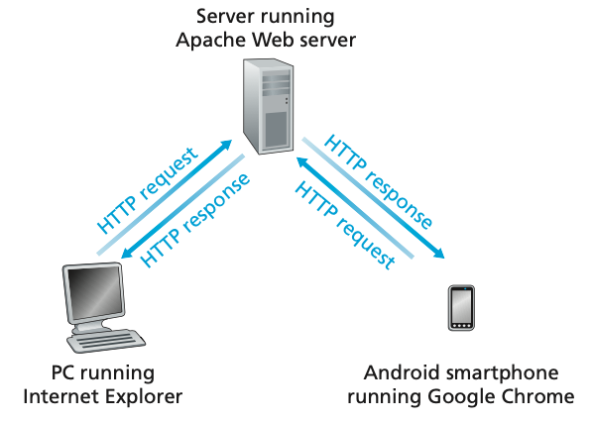
HTTP request-response behavior
Notes:
HTTP: hypertext transfer protocol
HTTP defines how Web clients request Web pages from Web servers and how servers transfer Web pages to clients.
When a user requests a Web page (for example, clicks on a hyperlink), the browser sends HTTP request messages for the objects in the page to the server.
The server receives the requests and responds with HTTP response messages that contain the objects.

Slide 25
HTTP overview (continued)
HTTP uses TCP:
client initiates TCP connection (creates socket) to server, port 80
server accepts TCP connection from client
HTTP messages (application-layer protocol messages) exchanged between browser (HTTP client) and Web server (HTTP server)
TCP connection closed
HTTP is “stateless”
server maintains no information about past client requests
aside
protocols that maintain “state” are complex!
past history (state) must be maintained
if server/client crashes, their views of “state” may be inconsistent, must be reconciled
Notes:
It is important to note that the server sends requested files to clients without storing any state information about the client. If a particular client asks for the same object twice in a period of a few seconds, the server does not respond by saying that it just served the object to the client; instead, the server resends the object, as it has completely forgotten what it did earlier. Because an HTTP server maintains no infor-ation about the clients, HTTP is said to be a stateless protocol. We also remark that the Web uses the client-server application architecture. A Web server is always on, with a fixed IP address, and it services requests from potentially millions of different browsers.

Slide 26
HTTP connections: two types
Non-persistent HTTP
TCP connection opened
at most one object sent over TCP connection
TCP connection closed
downloading multiple objects required multiple connections
Persistent HTTP
TCP connection opened to a server
multiple objects can be sent over single TCP connection between client, and that server
TCP connection closed
Notes:
In many Internet applications, the client and server communicate for an extended period of time, with the client making a series of requests and the server responding to each of the requests. Depending on the application and on how the applica- tion is being used, the series of requests may be made back-to-back, periodically at regular intervals, or intermittently. When this client-server interaction is taking place over TCP, the application developer needs to make an important decision—should each request/response pair be sent over a separate TCP connection, or should all of the requests and their corresponding responses be sent over the same TCP connection? In the former approach, the application is said to use non-persistent connections; and in the latter approach, persistent connections.

Slide 27
Non-persistent HTTP: example
User enters URL:
www.someSchool.edu/someDepartment/home.index
(containing text, references to 10 jpeg images)
1a. HTTP client initiates TCP connection to HTTP server (process) at www.someSchool.edu on port 80
1b. HTTP server at host www.someSchool.edu waiting for TCP connection at port 80 “accepts” connection, notifying client
2. HTTP client sends HTTP request message (containing URL) into TCP connection socket. Message indicates that client wants object someDepartment/home.index
3. HTTP server receives request message, forms response message containing requested object, and sends message into its socket
time

Slide 28
Non-persistent HTTP: example (cont.)
User enters URL:
www.someSchool.edu/someDepartment/home.index
(containing text, references to 10 jpeg images)
4. HTTP server closes TCP connection.
5. HTTP client receives response message containing html file, displays html. Parsing html file, finds 10 referenced jpeg objects
6. Steps 1-5 repeated for each of 10 jpeg objects
time

Slide 29
Non-persistent HTTP: response time
RTT (definition): time for a small packet to travel from client to server and back
HTTP response time (per object):
one RTT to initiate TCP connection
one RTT for HTTP request and first few bytes of HTTP response to return
object/file transmission time
initiate TCP
connection
RTT
request file
RTT
time to
transmit
file
file received
time
time
Non-persistent HTTP response time = 2RTT+ file transmission time

Slide 30
Persistent HTTP (HTTP 1.1)
Non-persistent HTTP issues:
requires 2 RTTs per object
OS overhead for each TCP connection
browsers often open multiple parallel TCP connections to fetch referenced objects in parallel
Persistent HTTP (HTTP1.1):
server leaves connection open after sending response
subsequent HTTP messages between same client/server sent over open connection
client sends requests as soon as it encounters a referenced object
as little as one RTT for all the referenced objects (cutting response time in half)

Slide 31
HTTP request message
two types of HTTP messages: request, response
HTTP request message:
  ASCII (human-readable format)
carriage return character
line-feed character
request line (GET, POST,
HEAD commands)
GET /index.html HTTP/1.1\r\n
Host: www-net.cs.umass.edu\r\n
User-Agent: Firefox/3.6.10\r\n
Accept: text/html,application/xhtml+xml\r\n
Accept-Language: en-us,en;q=0.5\r\n
Accept-Encoding: gzip,deflate\r\n
Accept-Charset: ISO-8859-1,utf-8;q=0.7\r\n
Keep-Alive: 115\r\n
Connection: keep-alive\r\n
\r\n
header
lines
carriage return, line feed at start of line indicates end of header lines
* Check out the online interactive exercises for more examples: http://gaia.cs.umass.edu/kurose_ross/interactive/

Slide 32
HTTP request message: general format
method
sp
URL
sp
version
cr
lf
request
line
header field name
value
cr
lf
~
~
header
lines
~
~
header field name
value
cr
lf
cr
lf
~
entity body
~
body
~
~

Slide 33
Other HTTP request messages
POST method:
web page often includes form input
user input sent from client to server in entity body of HTTP POST request message
HEAD method:
requests headers (only) that would be returned if specified URL were requested with an HTTP GET method.
PUT method:
uploads new file (object) to server
completely replaces file that exists at specified URL with content in entity body of POST HTTP request message
GET method (for sending data to server):
include user data in URL field of HTTP GET request message (following a ‘?’):
www.somesite.com/animalsearch?monkeys&banana

Slide 34
HTTP response message
status line (protocol
status code status phrase)
HTTP/1.1 200 OK\r\n
Date: Sun, 26 Sep 2010 20:09:20 GMT\r\n
Server: Apache/2.0.52 (CentOS)\r\n
Last-Modified: Tue, 30 Oct 2007 17:00:02 GMT\r\n
ETag: "17dc6-a5c-bf716880"\r\n
Accept-Ranges: bytes\r\n
Content-Length: 2652\r\n
Keep-Alive: timeout=10, max=100\r\n
Connection: Keep-Alive\r\n
Content-Type: text/html; charset=ISO-8859-1\r\n
\r\n
data data data data data ...
header
lines
data, e.g., requested
HTML file
* Check out the online interactive exercises for more examples: http://gaia.cs.umass.edu/kurose_ross/interactive/

Slide 35
HTTP response status codes
status code appears in 1st line in server-to-client response message.
some sample codes:
200 OK
  request succeeded, requested object later in this message
301 Moved Permanently
  requested object moved, new location specified later in this message (in Location: field)
400 Bad Request
  request msg not understood by server
404 Not Found
  requested document not found on this server
505 HTTP Version Not Supported

Slide 36
Trying out HTTP (client side) for yourself
1. Telnet to your favorite Web server:
telnet gaia.cs.umass.edu 80
opens TCP connection to port 80 (default HTTP server port) at gaia.cs.umass. edu.
anything typed in will be sent to port 80 at gaia.cs.umass.edu
2. type in a GET HTTP request:
GET /kurose_ross/interactive/index.php HTTP/1.1
Host: gaia.cs.umass.edu
by typing this in (hit carriage return twice), you send this minimal (but complete) GET request to HTTP server
3. look at response message sent by HTTP server!
(or use Wireshark to look at captured HTTP request/response)

Slide 37

Maintaining user/server state: cookies
Recall: HTTP GET/response interaction is stateless
no notion of multi-step exchanges of HTTP messages to complete a Web “transaction”
  no need for client/server to track “state” of multi-step exchange
  all HTTP requests are independent of each other
  no need for client/server to “recover” from a partially-completed-but-never-completely-completed transaction
a stateful protocol: client makes two changes to X, or none at all
X
lock data record X
X
OK
update X X’
X’
OK
t’
update X X’’
OK
X’’
unlock X
OK
X’’
time
time
Q: what happens if network connection or client crashes at t’ ?
Notes:
t’

Slide 38
Maintaining user/server state: cookies
Web sites and client browser use cookies to maintain some state between transactions
four components:
  1) cookie header line of HTTP response message
  2) cookie header line in next HTTP request message
  3) cookie file kept on user’s host, managed by user’s browser
  4) back-end database at Web site
Example:
Susan uses browser on laptop, visits specific e-commerce site for first time
when initial HTTP requests arrives at site, site creates:
  unique ID (aka “cookie”)
  entry in backend database for ID
subsequent HTTP requests from Susan to this site will contain cookie ID value, allowing site to “identify” Susan
Notes:
t’

Slide 39
Maintaining user/server state: cookies
client
server
ebay 8734
usual HTTP request msg
Amazon server
creates ID
1678 for user
cookie file
usual HTTP response
set-cookie: 1678
backend
database
create
entry
ebay 8734
amazon 1678
usual HTTP request msg
cookie: 1678
cookie-
specific
action
access
usual HTTP response msg
one week later:
access
ebay 8734
amazon 1678
usual HTTP request msg
cookie: 1678
cookie-
specific
action
usual HTTP response msg
time
time
Notes:
t’

Slide 40
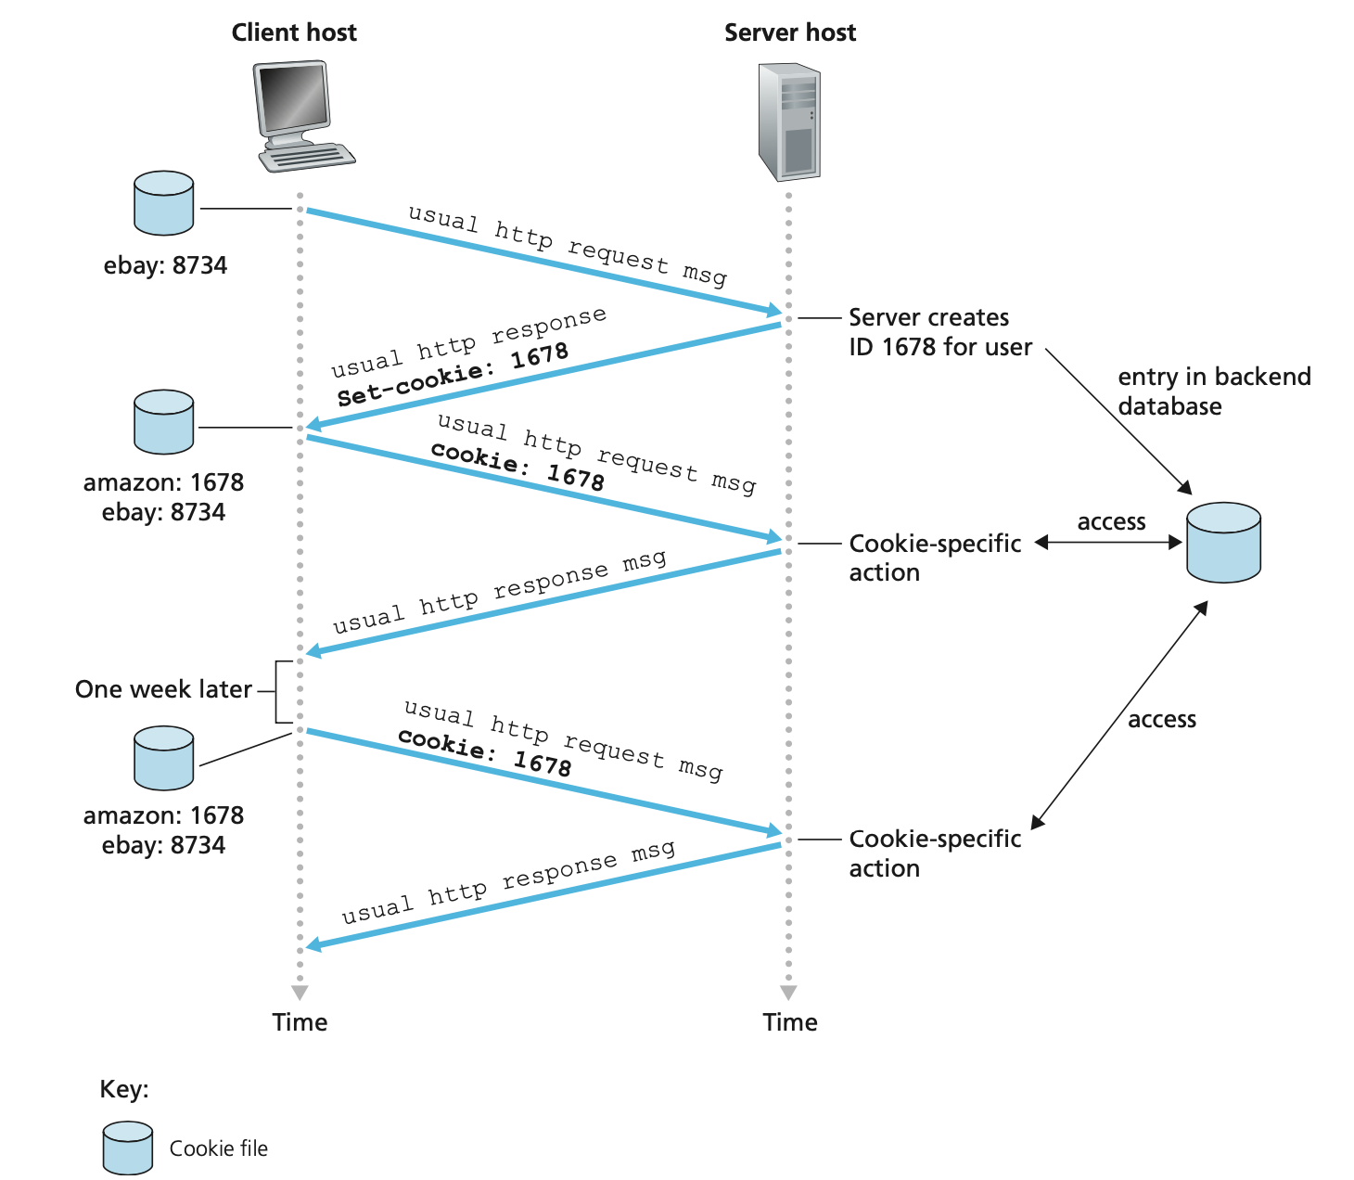
Keeping User State with “cookies”

Slide 41
HTTP cookies: comments
aside
What cookies can be used for:
authorization
shopping carts
recommendations
user session state (Web e-mail)
cookies and privacy:
cookies permit sites to learn a lot about you on their site.
third party persistent cookies (tracking cookies) allow common identity (cookie value) to be tracked across multiple web sites
Challenge: How to keep state:
protocol endpoints: maintain state at sender/receiver over multiple transactions
cookies: HTTP messages carry state
Notes:
t’

Slide 42

Web caches (proxy servers)
Goal: satisfy client request without involving origin server
user configures browser to point to a Web cache
browser sends all HTTP requests to cache
  if object in cache: cache returns object to client
  else cache requests object from origin server, caches received object, then returns object to client
proxy
server
HTTP request
HTTP request
client
HTTP response
HTTP response
origin
server
HTTP request
HTTP response
client
origin
server
Notes:
The browser establishes a TCP connection to the Web cache and sends an HTTP request for the object to the Web cache.
The Web cache checks to see if it has a copy of the object stored locally. If it does, the Web cache returns the object within an HTTP response message to the client browser.
If the Web cache does not have the object, the Web cache opens a TCP connec- tion to the origin server, that is, to www.someschool.edu. The Web cache then sends an HTTP request for the object into the cache-to-server TCP connec- tion. After receiving this request, the origin server sends the object within an HTTP response to the Web cache.
When the Web cache receives the object, it stores a copy in its local storage and sends a copy, within an HTTP response message, to the client browser (over the existing TCP connection between the client browser and the Web cache).

Slide 43
Web caches (proxy servers)
Web cache acts as both client and server
  server for original requesting client
  client to origin server
typically cache is installed by ISP (university, company, residential ISP)
Why Web caching?
reduce response time for client request
  cache is closer to client
reduce traffic on an institution’s access link
Internet is dense with caches
  enables “poor” content providers to more effectively deliver content
Notes:
re: poor content providers – like in real-estate, location is everything. servers want to be close to clients.

Slide 44

Caching Example A: slim access link
assumptions:
avg object size: 1Mbits
avg request rate from browsers to origin servers:15/sec
RTT from institutional router to any origin server: 2 sec (Internet delay)
access link rate: 15 Mbps
LAN delay = 10ms = 0.01s
consequences:
LAN utilization:
= La/R = 15req/sec x 1Mbits/ 100Mbps
= 0.15 = 15%
access link utilization
= La/R = 15req/sec x 1Mbits/ 15Mbps
= 1= 100%
total delay = Internet delay + access link delay +
LAN delay
= 2 sec + minutes + µsecs
= minutes
origin
servers
public
Internet
15 Mbps (original bandwidth)
problem!
institutional
network
100 Mbps LAN
≈10ms
Traffic intensity=La/R 🡪 1 (heavy congested)

Slide 45
Caching Example A: fatter access link
assumptions:
avg object size: 1Mbits
avg request rate from browsers to origin servers:15/sec
RTT from institutional router to any origin server: 2 sec (Internet delay)
access link rate: 15 Mbps 🡪 100Mbps
LAN delay = 10ms = 0.01s
consequences:
LAN utilization:
= La/R = 15req/sec x 1Mbits/ 100Mbps
= 0.15 = 15%
access link utilization
= La/R = 15req/sec x 1Mbits/ 100Mbps
= 0.15 = 15%
(from 100% reduce to 15%)
total delay = Internet delay + access link delay +
LAN delay
= 2 sec + µsecs + µsecs
≈ 2 sec (Internet delay)
origin
servers
public
Internet
15 Mbps
access link
100 Mbps
institutional
network
100 Mbps LAN
≈10ms
Cost: increased access link speed (not cheap!)

Slide 46
Caching Example A: install local web cache
assumptions:
avg object size: 1Mbits
avg request rate from browsers to origin servers:15/sec
RTT from institutional router to any origin server: 2 sec
access link rate: 15 Mbps
LAN delay =10ms = 0.01s
consequences:
LAN utilization: 15%
access link utilization = ?
total delay = ?
origin
servers
public
Internet
15 Mbps (original bandwidth)
access link
institutional
network
100 Mbps LAN
local web
cache
How to compute link
utilization, delay?

Slide 47
Caching Example A: install local web cache
Calculating access link utilization, delay with cache:
suppose cache hit rate is 0.4
  40% requests satisfied at cache, 60% requests satisfied at origin
origin
servers
public
Internet
access link utilization:
  60% of requests use access link
data rate to browsers over access link
= 0.6*15 Mbps = 9 Mbps
  utilization = 9/15 = 0.6 (i.e. 60%)
15 Mbps
access link
institutional
network
total delay
  = 0.6 * (delay from origin servers) +0.4 * (delay when satisfied at cache)
  = 0.6 (2 + 0.01(LAN delay)) + 0.4 (~msecs)
  = 0.6 (2.01) + 0.4 (0.01 (LAN delay))
  = 1.21secs = ~1.2secs
100 Mbps LAN
local web
cache
≈10ms
Cost: web cache (cheap!)

Slide 48
Caching Example B
Scenario:
access link rate: 1.54 Mbps
RTT from institutional router to server: 2 sec
Web object size: 100K bits
Average request rate from browsers to origin servers: 15/sec
  average data rate to browsers: 1.50 Mbps
origin
servers
public
Internet
1.54 Mbps
access link
Performance:
LAN utilization: .0015
access link utilization = .97
end-end delay = Internet delay +
access link delay + LAN delay
= 2 sec + minutes + usecs
problem: large delays at high utilization!
institutional
network
1 Gbps LAN
Notes:
explain why minutes (recall earlier delay versus arrival rate curve from Chapter 1)

Slide 49
Caching Example B: buy a faster access link
Scenario:
access link rate: 1.54 Mbps
RTT from institutional router to server: 2 sec
Web object size: 100K bits
Avg request rate from browsers to origin servers: 15/sec
  avg data rate to browsers: 1.50 Mbps
154 Mbps
origin
servers
public
Internet
154 Mbps
1.54 Mbps
access link
Performance:
LAN utilization: .0015
access link utilization = .97
end-end delay = Internet delay +
access link delay + LAN delay
= 2 sec + minutes + usecs
institutional
network
.0097
1 Gbps LAN
Cost: faster access link (expensive!)
msecs
Notes:
t’

Slide 50
Caching Example B: install a web cache
Scenario:
access link rate: 1.54 Mbps
RTT from institutional router to server: 2 sec
Web object size: 100K bits
Avg request rate from browsers to origin servers: 15/sec
  avg data rate to browsers: 1.50 Mbps
origin
servers
public
Internet
1.54 Mbps
access link
Performance:
LAN utilization: .?
access link utilization = ?
average end-end delay = ?
institutional
network
How to compute link
utilization, delay?
1 Gbps LAN
Cost: web cache (cheap!)
local web cache
Notes:
t’

Slide 51
Caching Example B: install a web cache
Calculating access link utilization, end-end delay with cache:
suppose cache hit rate is 0.4: 40% requests satisfied at cache, 60% requests satisfied at origin
origin
servers
public
Internet
access link: 60% of requests use access link
data rate to browsers over access link
= 0.6 * 1.50 Mbps = .9 Mbps
utilization = 0.9/1.54 = .58
1.54 Mbps
access link
institutional
network
average end-end delay
  = 0.6 * (delay from origin servers)
  + 0.4 * (delay when satisfied at cache)
  = 0.6 (2.01) + 0.4 (~msecs) = ~ 1.2 secs
1 Gbps LAN
local web cache
lower average end-end delay than with 154 Mbps link (and cheaper too!)
Notes:
t’

Slide 52
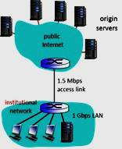
Example Problem:
    The diagram shows an institutional network connected to public Internet. Answer the following questions based on the assumption below:
  Average object size: 100K bits, average request rate from browsers to origin servers: 15/sec, access link rate: 1.5 Mbps, & access LAN: 1Gbps
i) Without web cache server, calculate access link utilization.
ii) Assume the access link rate is increased to 3Mbps. Without web cache server, calculate the access link utilization.
iii) Assume the link capacity is unchanged (1.5Mbps) and a web server cache is used which has a hit rate of 50%, find the access link utilization.
iv) Discuss the results in B and C (in terms of utilization). What is your conclusion?

Slide 53
Conditional GET
client
server
Goal: don’t send object if cache has up-to-date cached version
  no object transmission delay
  lower link utilization
cache: specify date of cached copy in HTTP request
  If-modified-since: <date>
server: response contains no object if cached copy is up-to-date:
  HTTP/1.0 304 Not Modified
HTTP request msg
If-modified-since: <date>
object
not
modified
before
<date>
HTTP response
HTTP/1.0
304 Not Modified
HTTP request msg
If-modified-since: <date>
object
modified
after
<date>
HTTP response
HTTP/1.0 200 OK
<data>
Notes:
t’

Slide 54
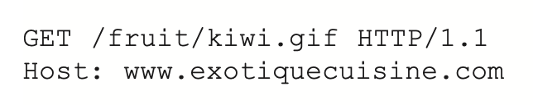
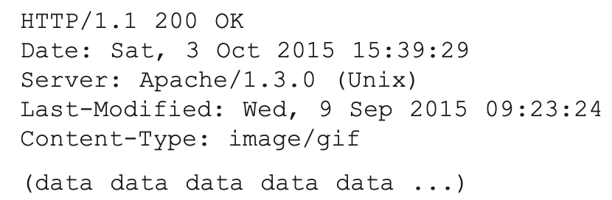
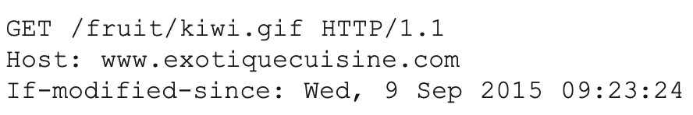
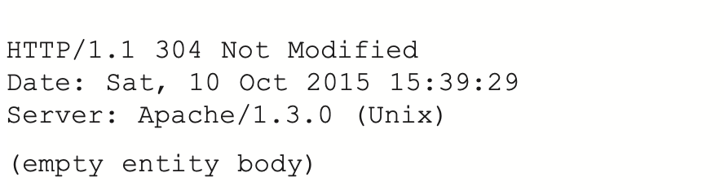
Conditional GET
client
server
object
modified
after
<date>
one week later
object
not
modified
before
<date>

Slide 55
HTTP/2
Key goal: decreased delay in multi-object HTTP requests
HTTP1.1: introduced multiple, pipelined GETs over single TCP connection
server responds in-order (FCFS: first-come-first-served scheduling) to GET requests
with FCFS, small object may have to wait for transmission (head-of-line (HOL) blocking) behind large object(s)
loss recovery (retransmitting lost TCP segments) stalls object transmission
Notes:
t’

Slide 56
HTTP/2
Key goal: decreased delay in multi-object HTTP requests
HTTP/2: [RFC 7540, 2015] increased flexibility at server in sending objects to client:
methods, status codes, most header fields unchanged from HTTP 1.1
transmission order of requested objects based on client-specified object priority (not necessarily FCFS)
push unrequested objects to client
divide objects into frames, schedule frames to mitigate HOL blocking
Notes:
t’

Slide 57
HTTP/2: mitigating HOL blocking
HTTP 1.1: client requests 1 large object (e.g., video file, and 3 smaller objects)
server
GET O₄
GET O₃
GET O₂
GET O₁
object data requested
client
O₁
O₂
O₁
O₃
O₂
O₃
O₄
O₄
objects delivered in order requested: O₂, O₃, O₄ wait behind O₁
Notes:
t’

Slide 58
HTTP/2: mitigating HOL blocking
HTTP/2: objects divided into frames, frame transmission interleaved
server
GET O₄
GET O₃
GET O₂
GET O₁
object data requested
client
O₂
O₄
O₃
O₁
O₂
O₃
O₄
O₁
O₂, O₃, O₄ delivered quickly, O₁ slightly delayed
Notes:
shortest job first: decreased average delay!

Slide 59
HTTP/2 to HTTP/3
Key goal: decreased delay in multi-object HTTP requests
HTTP/2 over single TCP connection means:
recovery from packet loss still stalls all object transmissions
  as in HTTP 1.1, browsers have incentive to open multiple parallel TCP connections to reduce stalling, increase overall throughput
no security over vanilla TCP connection
HTTP/3: adds security , per object error- and congestion-control (more pipelining) over UDP
  more on HTTP/3 in transport layer
Notes:
t’

Slide 60
Application layer: overview
P2P applications
video streaming and content distribution networks
socket programming with UDP and TCP
Principles of network applications
Web and HTTP
E-mail, SMTP, IMAP
The Domain Name System DNS

Slide 61
E-mail
outgoing
message queue
user mailbox
user
agent
Three major components:
user agents
mail servers
simple mail transfer protocol: SMTP
User Agent
a.k.a. “mail reader”
composing, editing, reading mail messages
e.g., Outlook, iPhone mail client
outgoing, incoming messages stored on server
mail
server
user
agent
SMTP
mail
server
user
agent
SMTP
SMTP
user
agent
mail
server
user
agent
user
agent

Slide 62
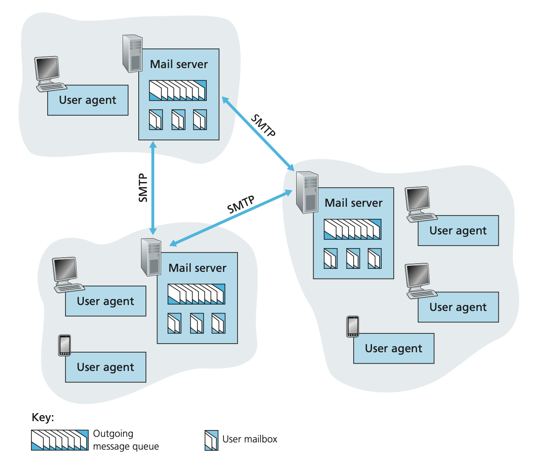
A high-level view of the Internet e-mail system

Slide 63
E-mail: mail servers
outgoing
message queue
user mailbox
user
agent
mail servers:
mailbox contains incoming messages for user
message queue of outgoing (to be sent) mail messages
SMTP protocol between mail servers to send email messages
  client: sending mail server
  “server”: receiving mail server
mail
server
user
agent
SMTP
mail
server
user
agent
SMTP
SMTP
user
agent
mail
server
user
agent
user
agent

Slide 64
E-mail: the RFC (5321)
uses TCP to reliably transfer email message from client (mail server initiating connection) to server, port 25
direct transfer: sending server (acting like client) to receiving server
three phases of transfer
  handshaking (greeting)
  transfer of messages
  closure
command/response interaction (like HTTP)
  commands: ASCII text
  response: status code and phrase
messages must be in 7-bit ASCI

Slide 65


Scenario: Alice sends e-mail to Bob
1) Alice uses UA to compose e-mail message “to” bob@someschool.edu
4) SMTP client sends Alice’s message over the TCP connection
2) Alice’s UA sends message to her mail server; message placed in message queue
5) Bob’s mail server places the message in Bob’s mailbox
3) client side of SMTP opens TCP connection with Bob’s mail server
6) Bob invokes his user agent to read message
user
agent
mail
server
user
agent
1
mail
server
2
3
6
4
Alice’s mail server
5
Bob’s mail server

Slide 66
Sample SMTP interaction
S: 220 hamburger.edu
C: HELO crepes.fr
S: 250 Hello crepes.fr, pleased to meet you
C: MAIL FROM: <alice@crepes.fr>
S: 250 alice@crepes.fr... Sender ok
C: RCPT TO: <bob@hamburger.edu>
S: 250 bob@hamburger.edu ... Recipient ok
C: DATA
S: 354 Enter mail, end with "." on a line by itself
C: Do you like ketchup?
C: How about pickles?
C: .
S: 250 Message accepted for delivery
C: QUIT
S: 221 hamburger.edu closing connection

Slide 67
Try SMTP interaction for yourself:
telnet <servername> 25
see 220 reply from server
enter HELO, MAIL FROM:, RCPT TO:, DATA, QUIT commands
above lets you send email without using e-mail client (reader)
Note: this will only work if <servername> allows telnet connections to port 25 (this is becoming increasingly rare because of security concerns)
Notes:
To do this, issue
telnet serverName 25
where serverName is the name of a local mail server. When you do this, you are simply establishing a TCP connection between your local host and the mail server. After typing this line, you should immediately receive the 220 reply from the server. Then issue the SMTP commands HELO, MAIL FROM, RCPT TO, DATA, CRLF.CRLF, and QUIT at the appropriate times.

Slide 68
SMTP: closing observations
comparison with HTTP:
HTTP: pull
SMTP: push
both have ASCII command/response interaction, status codes
HTTP: each object encapsulated in its own response message
SMTP: multiple objects sent in multipart message
SMTP uses persistent connections
SMTP requires message (header & body) to be in 7-bit ASCII
SMTP server uses CRLF. CRLF to determine end of message
Notes:
HTTP is mainly a pull protocol—someone loads information on a Web server and users use HTTP to pull the information from the server at their convenience. In particular, the TCP connection is initiated by the machine that wants to receive the file.
SMTP is primarily a push protocol—the sending mail server pushes the file to the receiving mail server. In particular, the TCP connection is initiated by the machine that wants to send the file
A second difference, which we alluded to earlier, is that SMTP requires each message, including the body of each message, to be in 7-bit ASCII format. If the message contains characters that are not 7-bit ASCII (for example, French characters with accents) or contains binary data (such as an image file), then the message has to be encoded into 7-bit ASCII. HTTP data does not impose this restriction.
A third important difference concerns how a document consisting of text and images (along with possibly other media types) is handled

Slide 69
Mail message format
SMTP: protocol for exchanging e-mail messages, defined in RFC 5321 (like HTTP)
RFC 822 defines syntax for e-mail message itself (like HTML)
header lines, e.g.,
  To:
  From:
  Subject:
  these lines, within the body of the email message area different from SMTP MAIL FROM:, RCPT TO: commands!
Body: the “message” , ASCII characters only
header
blank
line
body

Slide 70
Mail access protocols
user
agent
e-mail access
protocol
user
agent
SMTP
SMTP
(e.g., IMAP, HTTP)
sender’s e-mail
server
receiver’s e-mail
server
SMTP: delivery/storage of e-mail messages to receiver’s server
mail access protocol: retrieval from server
  IMAP: Internet Mail Access Protocol [RFC 3501]: messages stored on server, IMAP provides retrieval, deletion, folders of stored messages on server
  POP3: Post Office Protocol [RFC 1939]: authorization, download
HTTP (Web based Email): gmail, Hotmail, Yahoo!Mail, etc. provides web-based interface on top of STMP (to send), IMAP (or POP3) to retrieve e-mail messages

Slide 71
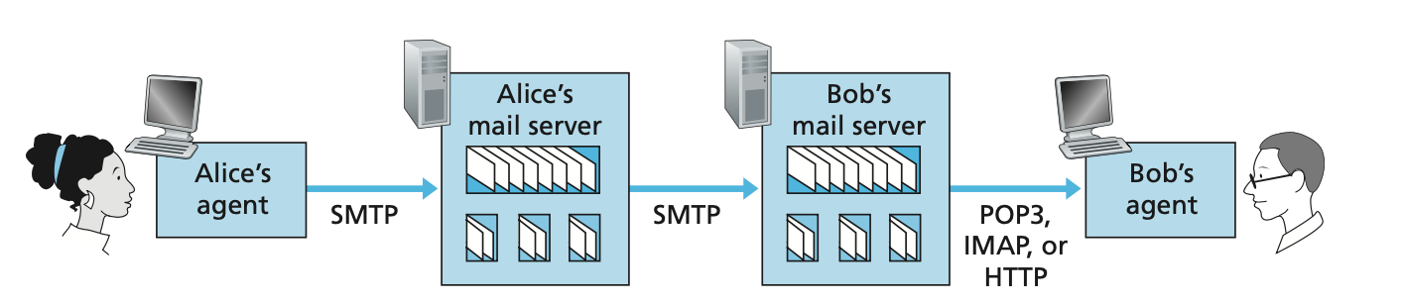
Mail access protocols
Notes:
Alice’s user agent uses SMTP to push the e-mail message into her mail server, then Alice’s mail server uses SMTP (as an SMTP client) to relay the e-mail message to Bob’s mail server. Why the two-step procedure? Primarily because without relaying through Alice’s mail server, Alice’s user agent doesn’t have any recourse to an unreachable destination
mail server. By having Alice first deposit the e-mail in her own mail server, Alice’s mail server can repeatedly try to send the message to Bob’s mail server, say every 30 minutes, until Bob’s mail server becomes operational. (And if Alice’s mail server is down, then she has the recourse of complaining to her system administrator!) The SMTP RFC defines how the SMTP commands can be used to relay a message across multiple SMTP servers.
But there is still one missing piece to the puzzle! How does a recipient like Bob, running a user agent on his local PC, obtain his messages, which are sitting in a mail server within Bob’s ISP? Note that Bob’s user agent can’t use SMTP to obtain the messages because obtaining the messages is a pull operation, whereas SMTP is a push protocol. The puzzle is completed by introducing a special mail access protocol that transfers messages from Bob’s mail server to his local PC. There are currently a number of popular mail access protocols, including Post Office Protocol—Version 3 (POP3), Internet Mail Access Protocol (IMAP), and HTTP.

Slide 72
POP3 protocol
S: +OK POP3 server ready
C: user bob
S: +OK
C: pass hungry
S: +OK user successfully logged on
authorization phase
client commands:
  user: declare username
  pass: password
server responses
  +OK
  -ERR
transaction phase, client:
list: list message numbers
retr: retrieve message by number
dele: delete
quit
C: list
S: 1 498
S: 2 912
S: .
C: retr 1
S: <message 1 contents>
S: .
C: dele 1
C: retr 2
S: <message 1 contents>
S: .
C: dele 2
C: quit
S: +OK POP3 server signing off

Slide 73
POP3 and IMAP
more about POP3
previous example uses POP3 “download and delete” mode
  Bob cannot re-read e-mail if he changes client
POP3 “download-and-keep”: copies of messages on different clients
POP3 is stateless across sessions
IMAP
keeps all messages in one place: at server
allows user to organize messages in folders
keeps user state across sessions:
  names of folders and mappings between message IDs and folder name

Slide 74
Web-Based E-Mail
Hotmail introduced Web-based access mid 1990s.
The user agent is a Web browser, communicates with its remote mailbox via HTTP
To access e-mail message, user read mailbox in browser.
The e-mail message is sent from recipient’s mail server to it’s browser using HTTP protocol rather than POP3 or IMAP.
To send e-mail message, it is sent from user’s browser to mail server over HTTP rather than SMTP.

Slide 75
Application Layer: Overview
P2P applications
video streaming and content distribution networks
socket programming with UDP and TCP
Principles of network applications
Web and HTTP
E-mail, SMTP, IMAP
The Domain Name System DNS

Slide 76
DNS: Domain Name System
people: many identifiers:
  SSN, name, passport #
Internet hosts, routers:
  IP address (32 bit) - used for addressing datagrams
  “name”, e.g., cs.umass.edu - used by humans
Q: how to map between IP address and name, and vice versa ?
Domain Name System:
distributed database implemented in hierarchy of many name servers
application-layer protocol: hosts, name servers communicate to resolve names (address/name translation)
  note: core Internet function, implemented as application-layer protocol
  complexity at network’s “edge”

Slide 77
DNS: services, structure
DNS services
hostname to IP address translation
host aliasing
  canonical, alias names
mail server aliasing
load distribution
  replicated Web servers: many IP addresses correspond to one name
Q: Why not centralize DNS?
single point of failure
traffic volume
distant centralized database
maintenance
A: doesn‘t scale!
Comcast DNS servers alone: 600B DNS queries per day
Notes:
Host aliasing. A host with a complicated hostname can have one or more alias names. For example, a hostname such as relay1.west-coast .enterprise.com could have, say, two aliases such as enterprise.com and www.enterprise.com. In this case, the hostname relay1 .west-coast.enterprise.com is said to be a canonical hostname. Alias hostnames, when present, are typically more mnemonic than canonical host- names. DNS can be invoked by an application to obtain the canonical hostname for a supplied alias hostname as well as the IP address of the host.
Mail server aliasing. For obvious reasons, it is highly desirable that e-mail addresses be mnemonic. For example, if Bob has an account with Yahoo Mail, Bob’s e-mail address might be as simple as bob@yahoo.mail. However, the hostname of the Yahoo mail server is more complicated and much less mnemonic than simply yahoo.com (for example, the canonical hostname might be some- thing like relay1.west-coast.yahoo.com). DNS can be invoked by a mail application to obtain the canonical hostname for a supplied alias hostname as well as the IP address of the host. In fact, the MX record (see below) permits a company’s mail server and Web server to have identical (aliased) hostnames; for example, a company’s Web server and mail server can both be called enter- prise.com.
Load distribution. DNS is also used to perform load distribution among repli- cated servers, such as replicated Web servers. Busy sites, such as cnn.com, are replicated over multiple servers, with each server running on a different end system and each having a different IP address. For replicated Web servers, a set of IP addresses is thus associated with one canonical hostname. The DNS database con- tains this set of IP addresses. When clients make a DNS query for a name mapped to a set of addresses, the server responds with the entire set of IP addresses, but rotates the ordering of the addresses within each reply. Because a client typically sends its HTTP request message to the IP address that is listed first in the set, DNS rotation distributes the traffic among the replicated servers. DNS rotation is also used for e-mail so that multiple mail servers can have the same alias name. Also, content distribution companies such as Akamai have used DNS in more sophisti-cated ways [Dilley 2002] to provide Web content distribution

Slide 78
DNS: a distributed, hierarchical database
Root DNS Servers
Root
…
…
.com DNS servers
.org DNS servers
.edu DNS servers
Top Level Domain
…
…
…
…
yahoo.com
DNS servers
amazon.com
DNS servers
pbs.org
DNS servers
nyu.edu
DNS servers
umass.edu
DNS servers
Authoritative
Client wants IP address for www.amazon.com; 1st approximation:
client queries root server to find .com DNS server
client queries .com DNS server to get amazon.com DNS server
client queries amazon.com DNS server to get IP address for www.amazon.com

Slide 79
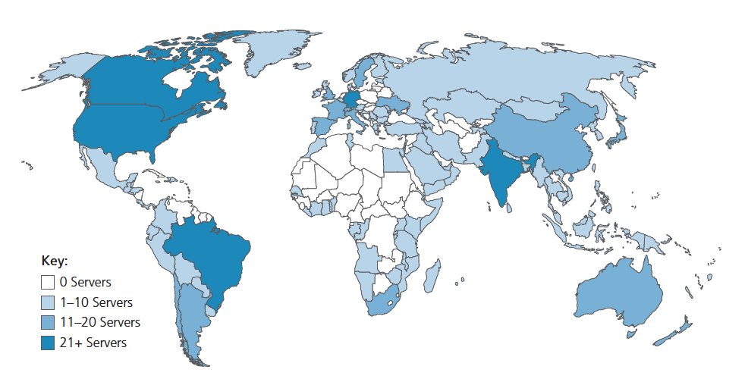
DNS: root name servers
official, contact-of-last-resort by name servers that can not resolve name
incredibly important Internet function
  Internet couldn’t function without it!
  DNSSEC – provides security (authentication and message integrity)
ICANN (Internet Corporation for Assigned Names and Numbers) manages root DNS domain
13 logical root name “servers” worldwide each “server” replicated many times (~200 servers in US)

Slide 80
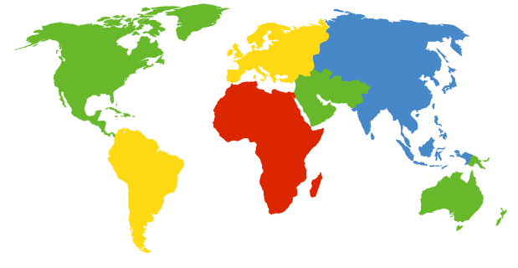
DNS: root name servers
contacted by local name server that cannot resolve name
root name server:
  contacts authoritative name server if name mapping not known
  gets mapping
  returns mapping to local name server
c. Cogent, Herndon, VA (5 other sites)
d. U Maryland College Park, MD
h. ARL Aberdeen, MD
j. Verisign, Dulles VA (69 other sites )
k. RIPE London (17 other sites)
i. Netnod, Stockholm (37 other sites)
e. NASA Mt View, CA
f. Internet Software C.
Palo Alto, CA (and 48 other sites)
m. WIDE Tokyo
(5 other sites)
13 logical root name “servers” worldwide
each “server” replicated (instances) many times
a. Verisign, Los Angeles CA
(5 other sites)
b. USC-ISI Marina del Rey, CA
l. ICANN Los Angeles, CA
(41 other sites)
g. US DoD Columbus, OH (5 other sites)

Slide 81
TLD: authoritative servers
Top-Level Domain (TLD) servers:
  responsible for .com, .org, .net, .edu, .aero, .jobs, .museums, and all top-level country domains, e.g.: .cn, .uk, .fr, .ca, .jp
  Network Solutions: authoritative registry for .com, .net TLD
  Educause: .edu TLD
Authoritative DNS servers:
  organization’s own DNS server(s), providing authoritative hostname to IP mappings for organization’s named hosts
  can be maintained by organization or service provider

Slide 82
Local DNS name servers
does not strictly belong to hierarchy
each ISP (residential ISP, company, university) has one
  also called “default name server”
when host makes DNS query, query is sent to its local DNS server
  has local cache of recent name-to-address translation pairs (but may be out of date!)
  acts as proxy, forwards query into hierarchy

Slide 83
DNS name resolution: iterated query
root DNS server
Example: host at engineering.nyu.edu wants IP address for gaia.cs.umass.edu
2
3
TLD DNS server
Iterated query:
contacted server replies with name of server to contact
“I don’t know this name, but ask this server”
1
4
8
5
requesting host at
engineering.nyu.edu
local DNS server
dns.nyu.edu
gaia.cs.umass.edu
7
6
authoritative DNS server
dns.cs.umass.edu

Slide 84
DNS name resolution: recursive query
root DNS server
Example: host at engineering.nyu.edu wants IP address for gaia.cs.umass.edu
2
3
7
6
Recursive query:
puts burden of name resolution on contacted name server
heavy load at upper levels of hierarchy?
1
TLD DNS server
8
requesting host at
engineering.nyu.edu
local DNS server
dns.nyu.edu
5
4
gaia.cs.umass.edu
authoritative DNS server
dns.cs.umass.edu

Slide 85
Caching, Updating DNS Records
once (any) name server learns mapping, it caches mapping
  cache entries timeout (disappear) after some time (TTL)
  TLD servers typically cached in local name servers
    thus root name servers not often visited
cached entries may be out-of-date (best-effort name-to-address translation!)
  if name host changes IP address, may not be known Internet-wide until all TTLs expire!
update/notify mechanisms proposed IETF standard
  RFC 2136

Slide 86
DNS records
DNS: distributed database storing resource records (RR)
RR format: (name, value, type, ttl)
type=A
  name is hostname
  value is IP address
type=CNAME
  name is alias name for some “canonical” (the real) name
  www.ibm.com is really servereast.backup2.ibm.com
  value is canonical name
type=NS
  name is domain (e.g., foo.com)
  value is hostname of authoritative name server for this domain
type=MX
  value is name of mailserver associated with name

Slide 87
DNS protocol messages
DNS query and reply messages, both have same format:
2 bytes
2 bytes
message header:
identification: 16 bit # for query, reply to query uses same #
flags:
  query or reply
  recursion desired
  recursion available
  reply is authoritative
identification
flags
# questions
# answer RRs
# authority RRs
# additional RRs
questions (variable # of questions)
answers (variable # of RRs)
authority (variable # of RRs)
additional info (variable # of RRs)

Slide 88
DNS protocol messages
DNS query and reply messages, both have same format:
2 bytes
2 bytes
identification
flags
# questions
# answer RRs
# authority RRs
# additional RRs
name, type fields for a query
questions (variable # of questions)
RRs in response to query
answers (variable # of RRs)
records for authoritative servers
authority (variable # of RRs)
additional “ helpful” info that may be used
additional info (variable # of RRs)

Slide 89
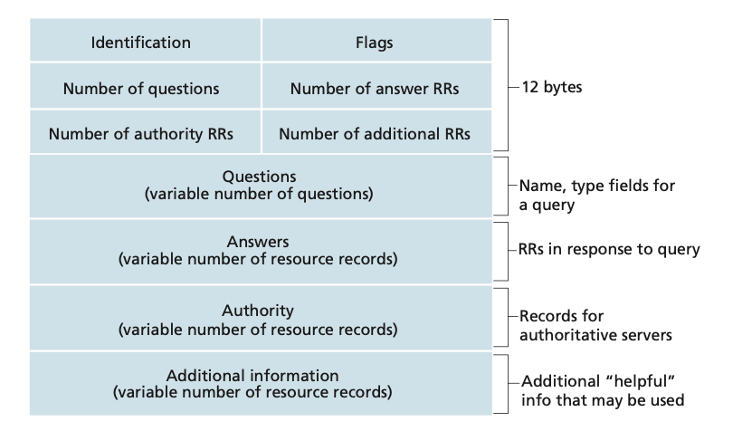
DNS message format

Slide 90
Inserting records into DNS
Example: new startup “Network Utopia”
register name networkuptopia.com at DNS registrar (e.g., Network Solutions)
  provide names, IP addresses of authoritative name server (primary and secondary)
  registrar inserts NS, A RRs into .com TLD server:
  (networkutopia.com, dns1.networkutopia.com, NS)
  (dns1.networkutopia.com, 212.212.212.1, A)
create authoritative server locally with IP address 212.212.212.1
  type A record for www.networkuptopia.com
  type MX record for networkutopia.com

Slide 91
DNS security
DDoS attacks
bombard root servers with traffic
  not successful to date
  traffic filtering
  local DNS servers cache IPs of TLD servers, allowing root server bypass
bombard TLD servers
  potentially more dangerous
Redirect attacks
man-in-middle
  intercept DNS queries
DNS poisoning
  send bogus relies to DNS server, which caches
Exploit DNS for DDoS
send queries with spoofed source address: target IP
requires amplification
DNSSEC
[RFC 4033]

Slide 92
Application Layer: Overview
P2P applications
video streaming and content distribution networks
socket programming with UDP and TCP
Principles of network applications
Web and HTTP
E-mail, SMTP, IMAP
The Domain Name System DNS

Slide 93
Peer-to-peer (P2P) architecture
no always-on server
arbitrary end systems directly communicate
peers request service from other peers, provide service in return to other peers
  self scalability – new peers bring new service capacity, and new service demands
peers are intermittently connected and change IP addresses
  complex management
examples: P2P file sharing (BitTorrent), streaming (KanKan), VoIP (Skype)
mobile network
national or global ISP
local or regional ISP
home network
content
provider
network
datacenter
network
enterprise
network

Slide 94
File distribution: client-server vs P2P
Q: how much time to distribute file (size F) from one server to N peers?
  peer upload/download capacity is limited resource
u_{s}: server upload capacity
d_{i}: peer i download capacity
file, size F
u₁
d₁
u₂
u_{s}
d₂
server
d_{i}
u_{N}
network (with abundant
bandwidth)
u_{i}
d_{N}
u_{i}: peer i upload capacity

Slide 95
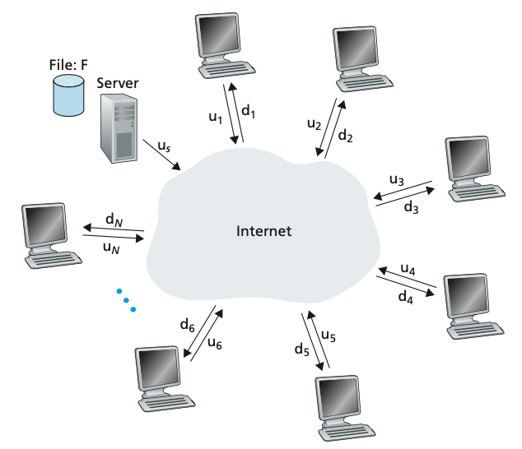
File distribution problem

Slide 96
File distribution time: client-server
server transmission: must sequentially send (upload) N file copies:
  time to send one copy: F/u_{s}
  time to send N copies: NF/u_{s}
F
u_{s}
d_{i}
network
client: each client must download file copy
  d_{min} = min client download rate
  min client download time: F/d_{min}
u_{i}
time to distribute F
to N clients using
client-server approach
D_{c-s} > max{NF/u_{s,},F/d_{min}}
increases linearly in N

Slide 97
File distribution time: P2P
server transmission: must upload at least one copy:
  time to send one copy: F/u_{s}
F
u_{s}
client: each client must download file copy
  min client download time: F/d_{min}
d_{i}
network
u_{i}
clients: as aggregate must download NF bits
  max upload rate (limiting max download rate) is u_{s} + Σu_{i}
time to distribute F
to N clients using
P2P approach
D_{P2P} > max{F/u_{s,},F/d_{min,},NF/(u_{s} + Σu_{i})}
increases linearly in N …
… but so does this, as each peer brings service capacity

Slide 98
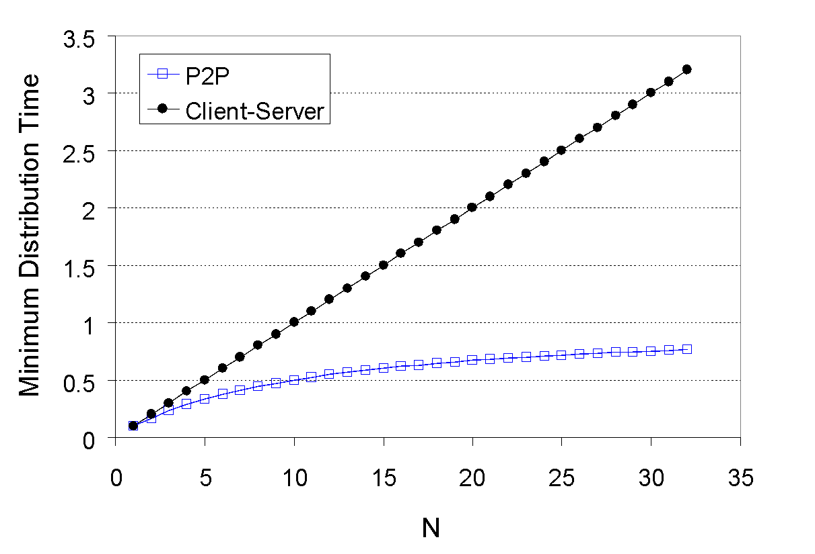
Client-server vs. P2P: example
client upload rate = u, F/u = 1 hour, u_{s} = 10u, d_{min} ≥ u_{s}

Slide 99
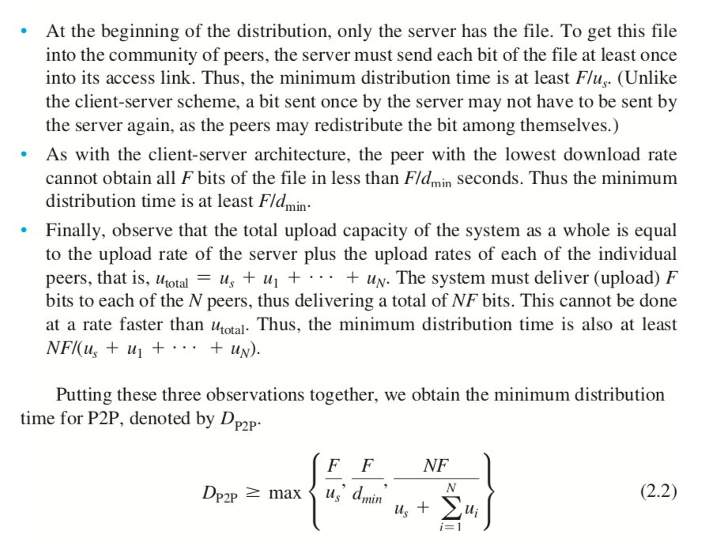

Slide 100
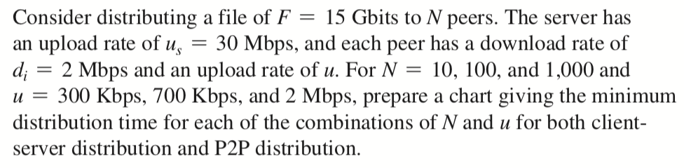
Exercise 2.5a
Using a base-2 system, often found in computing, then:
1 Gbit = 1024 Mbits
Kurose, J.F. and Ross, K.W. (2017). Computer Networking: A Top-Down Approach (7th Edition). Pearson Education Limited, England. (pp. 207)

Slide 101

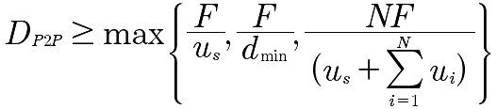
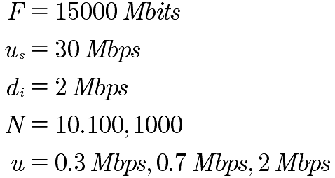
Solution
Time to distribute F to N clients:
Client-Server
P2P
15 X 1024 Mbits = 15360 Mbits
Kurose, J.F. and Ross, K.W. (2017). Computer Networking: A Top-Down Approach (7th Edition). Pearson Education Limited, England. (pp. 207)

Slide 102
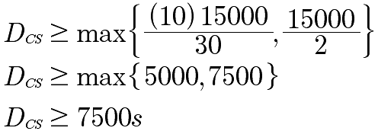
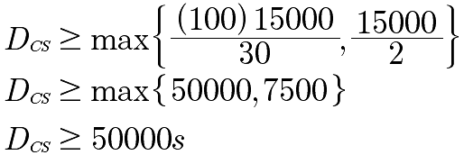
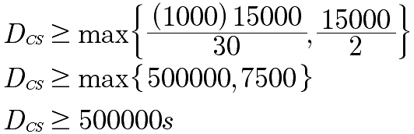
Client-Server
Solution
Time to distribute F to N clients:
15360
15360
5120
7680
7680s
15360
15360
51200
7680
15 X 1024 Mbits = 15360 Mbits
51200s
15360
15360
512000
7680
512000s
Kurose, J.F. and Ross, K.W. (2017). Computer Networking: A Top-Down Approach (7th Edition). Pearson Education Limited, England. (pp. 207)

Slide 103
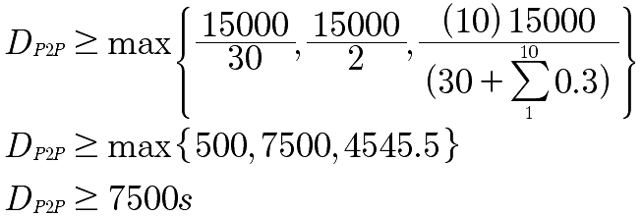
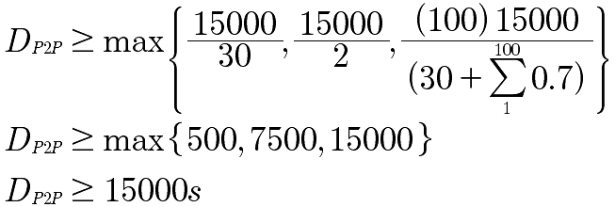
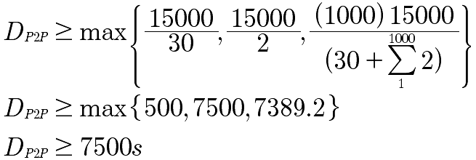
P2P
Solution
Time to distribute F to N clients:
15360
15360
15360
512
7680
4654.54
7680
15360
15360
15360
15 X 1024 Mbits = 15360 Mbits
512
7680
15360
15360
15360
15360
15360
512
7680
7566.50
7680
Kurose, J.F. and Ross, K.W. (2017). Computer Networking: A Top-Down Approach (7th Edition). Pearson Education Limited, England. (pp. 207)

Slide 104
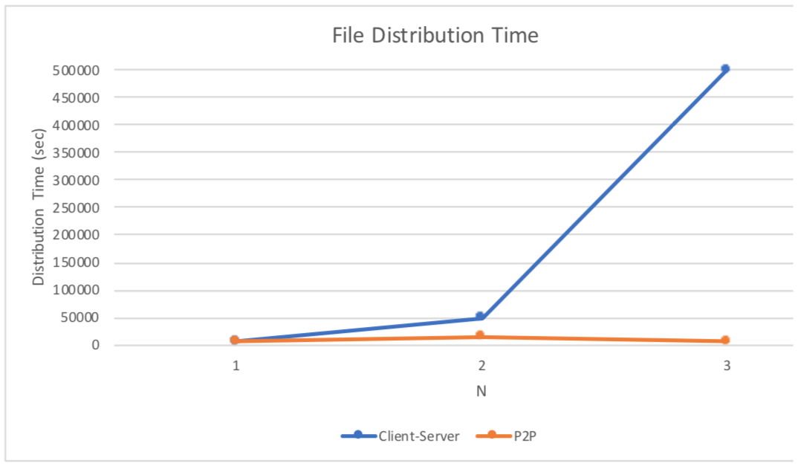
Solution
10 100 1000
Kurose, J.F. and Ross, K.W. (2017). Computer Networking: A Top-Down Approach (7th Edition). Pearson Education Limited, England. (pp. 207)

Slide 105

P2P file distribution: BitTorrent
file divided into 256Kb chunks
peers in torrent send/receive file chunks
tracker: tracks peers
participating in torrent
torrent: group of peers exchanging chunks of a file
Alice arrives …
… obtains list
of peers from tracker
… and begins exchanging
file chunks with peers in torrent

Slide 106


P2P file distribution: BitTorrent
peer joining torrent:
  has no chunks, but will accumulate them over time from other peers
  registers with tracker to get list of peers, connects to subset of peers (“neighbors”)
while downloading, peer uploads chunks to other peers
peer may change peers with whom it exchanges chunks
churn: peers may come and go
once peer has entire file, it may (selfishly) leave or (altruistically) remain in torrent

Slide 107
BitTorrent: requesting, sending file chunks
Requesting chunks:
at any given time, different peers have different subsets of file chunks
periodically, Alice asks each peer for list of chunks that they have
Alice requests missing chunks from peers, rarest first
Sending chunks: tit-for-tat
Alice sends chunks to those four peers currently sending her chunks at highest rate
  other peers are choked by Alice (do not receive chunks from her)
  re-evaluate top 4 every 10 secs
every 30 secs: randomly select another peer, starts sending chunks
  “optimistically unchoke” this peer
  newly chosen peer may join top 4

Slide 108
BitTorrent: tit-for-tat
(1) Alice “optimistically unchokes” Bob
(2) Alice becomes one of Bob’s top-four providers; Bob reciprocates
(3) Bob becomes one of Alice’s top-four providers
higher upload rate: find better trading partners, get file faster !

Slide 109
Application layer: overview
P2P applications
video streaming and content distribution networks
socket programming with UDP and TCP
Principles of network applications
Web and HTTP
E-mail, SMTP, IMAP
The Domain Name System DNS

Slide 110





Video Streaming and CDNs: context
stream video traffic: major consumer of Internet bandwidth
  Netflix, YouTube, Amazon Prime: 80% of residential ISP traffic (2020)
challenge: scale - how to reach ~1B users?
  single mega-video server won’t work (why?)
challenge: heterogeneity
  different users have different capabilities (e.g., wired versus mobile; bandwidth rich versus bandwidth poor)
solution: distributed, application-level infrastructure

Slide 111

Multimedia: video
spatial coding example: instead of sending N values of same color (all purple), send only two values: color value (purple) and number of repeated values (N)
video: sequence of images displayed at constant rate
  e.g., 24 images/sec
digital image: array of pixels
  each pixel represented by bits
coding: use redundancy within and between images to decrease # bits used to encode image
  spatial (within image)
  temporal (from one image to next)
……………………..
……………….…….
frame i
temporal coding example: instead of sending complete frame at i+1, send only differences from frame i
frame i+1

Slide 112
Multimedia: video
spatial coding example: instead of sending N values of same color (all purple), send only two values: color value (purple) and number of repeated values (N)
CBR: (constant bit rate): video encoding rate fixed
VBR: (variable bit rate): video encoding rate changes as amount of spatial, temporal coding changes
examples:
  MPEG 1 (CD-ROM) 1.5 Mbps
  MPEG2 (DVD) 3-6 Mbps
  MPEG4 (often used in Internet, 64Kbps – 12 Mbps)
……………………..
……………….…….
frame i
temporal coding example: instead of sending complete frame at i+1, send only differences from frame i
frame i+1

Slide 113


Streaming stored video
simple scenario:
Internet
video server
(stored video)
client
Main challenges:
server-to-client bandwidth will vary over time, with changing network congestion levels (in house, in access network, in network core, at video server)
packet loss and delay due to congestion will delay playout, or result in poor video quality

Slide 114
Streaming stored video
Cumulative data
2. video
sent
video
recorded (e.g., 30 frames/sec)
3. video received, played out at client
(30 frames/sec)
network delay
(fixed in this example)
time
streaming: at this time, client playing out early part of video, while server still sending later part of video

Slide 115
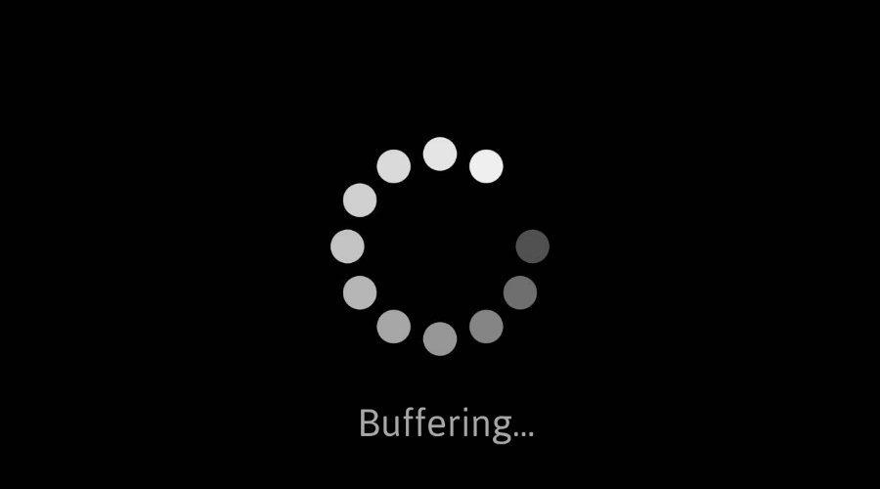
Streaming stored video: challenges
continuous playout constraint: once client playout begins, playback must match original timing
  … but network delays are variable (jitter), so will need client-side buffer to match playout requirements
other challenges:
  client interactivity: pause, fast-forward, rewind, jump through video
  video packets may be lost, retransmitted

Slide 116
Streaming stored video: playout buffering
constant bit
rate video
transmission
client video
reception
constant bit
rate video
playout at client
Cumulative data
variable
network
delay
buffered
video
client playout
delay
time
client-side buffering and playout delay: compensate for network-added delay, delay jitter

Slide 117
Streaming multimedia: DASH
DASH: Dynamic, Adaptive Streaming over HTTP
server:
  divides video file into multiple chunks
  each chunk stored, encoded at different rates
  manifest file: provides URLs for different chunks
client:
  periodically measures server-to-client bandwidth
  consulting manifest, requests one chunk at a time
    chooses maximum coding rate sustainable given current bandwidth
    can choose different coding rates at different points in time (depending on available bandwidth at time)
Internet
client

Slide 118
Streaming multimedia: DASH
“intelligence” at client: client determines
  when to request chunk (so that buffer starvation, or overflow does not occur)
  what encoding rate to request (higher quality when more bandwidth available)
Internet
client
  where to request chunk (can request from URL server that is “close” to client or has high available bandwidth)
Streaming video = encoding + DASH + playout buffering

Slide 119
Content distribution networks (CDNs)
challenge: how to stream content (selected from millions of videos) to hundreds of thousands of simultaneous users?
option 1: single, large “mega-server”
  single point of failure
  point of network congestion
  long path to distant clients
  multiple copies of video sent over outgoing link
….quite simply: this solution doesn’t scale

Slide 120


Content distribution networks (CDNs)
challenge: how to stream content (selected from millions of videos) to hundreds of thousands of simultaneous users?
option 2: store/serve multiple copies of videos at multiple geographically distributed sites (CDN)
  enter deep: push CDN servers deep into many access networks
    close to users
    Akamai: 240,000 servers deployed in more than 120 countries (2015)
  bring home: smaller number (10’s) of larger clusters in POPs near (but not within) access networks
    used by Limelight

Slide 121




Content distribution networks (CDNs)
CDN: stores copies of content at CDN nodes
  e.g. Netflix stores copies of MadMen
subscriber requests content from CDN
  directed to nearby copy, retrieves content
  may choose different copy if network path congested
…
…
…
manifest file
…
where’s Madmen?
…
…
Notes:
‹#›
Akamai: 100,000+ servers in 1000+ clusters in 1000+ networks in 70+ countries serving trillions of requests a day.
How many people use Netflix?

Slide 122
Content distribution networks (CDNs)
OTT: “over the top”
…
…
Internet host-host communication as a service
…
OTT challenges: coping with a congested Internet
  from which CDN node to retrieve content?
  viewer behavior in presence of congestion?
  what content to place in which CDN node?
…
…
…
Notes:
‹#›
peak load: 7million viewers, 2 Tbytes via

Slide 123
CDN content access: a closer look
Bob (client) requests video http://netcinema.com/6Y7B23V
video stored in CDN at http://KingCDN.com/NetC6y&B23V
1. Bob gets URL for video http://netcinema.com/6Y7B23V
from netcinema.com web page
2. resolve http://netcinema.com/6Y7B23V
via Bob’s local DNS
1
2
6. request video from
KINGCDN server,
streamed via HTTP
5
Bob’s
local DNS
server
netcinema.com
3. netcinema’s DNS returns CNAME for
http://KingCDN.com/NetC6y&B23V
4
3
netcinema’s
authoratative DNS
KingCDN.com
KingCDN
authoritative DNS

Slide 124
Case study: Netflix
Amazon cloud
upload copies of multiple versions of video to CDN servers
CDN
server
Netflix registration,
accounting servers
Bob browses
Netflix video
Manifest file, requested
returned for
specific video
CDN
server
2
1
3
Bob manages Netflix account
CDN
server
4
DASH server selected, contacted, streaming begins

Slide 125
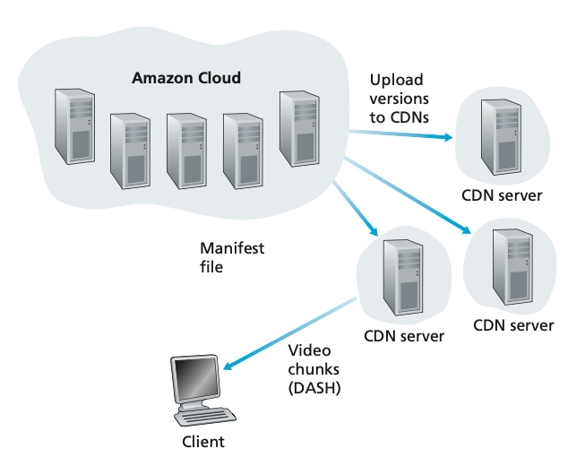
Case study: Netflix
Content ingestion. Ingest and process the movie. Netflix receives studio master versions of movies and uploads them to hosts in the Amazon cloud.
Content processing. create many different formats for each movie. A different version is created for each of these formats and at multiple bit rates, streaming over HTTP using DASH.
Uploading versions to its CDN. Once all of the versions of a movie have been created, the hosts in the Amazon cloud upload the versions to its CDN.

Slide 126
Application Layer: Overview
P2P applications
video streaming and content distribution networks
socket programming with UDP and TCP (Syllabus not covered)
Principles of network applications
Web and HTTP
E-mail, SMTP, IMAP
The Domain Name System DNS

Slide 127
Socket programming (Syllabus not covered)
goal: learn how to build client/server applications that communicate using sockets
socket: door between application process and end-end-transport protocol
application
socket
application
controlled by
app developer
process
process
transport
transport
network
network
controlled
by OS
link
Internet
link
physical
physical

Slide 128
Socket programming (Syllabus not covered)
  Two socket types for two transport services:
  UDP: unreliable datagram
  TCP: reliable, byte stream-oriented
  Application Example:
client reads a line of characters (data) from its keyboard and sends data to server
server receives the data and converts characters to uppercase
server sends modified data to client
client receives modified data and displays line on its screen

Slide 129
Socket programming with UDP (Syllabus not covered)
UDP: no “connection” between client & server
no handshaking before sending data
sender explicitly attaches IP destination address and port # to each packet
receiver extracts sender IP address and port# from received packet
UDP: transmitted data may be lost or received out-of-order
Application viewpoint:
UDP provides unreliable transfer of groups of bytes (“datagrams”) between client and server

Slide 130
Client/server socket interaction: UDP (Syllabus not covered)
server (running on serverIP)
client
create socket:
create socket, port= x:
clientSocket =
socket(AF_INET,SOCK_DGRAM)
serverSocket =
socket(AF_INET,SOCK_DGRAM)
Create datagram with server IP and
port=x; send datagram via
clientSocket
read datagram from
serverSocket
write reply to
serverSocket
specifying
client address,
port number
read datagram from
clientSocket
close
clientSocket

Slide 131
Example app: UDP client (Syllabus not covered)
Python UDPClient
include Python’s socket library
from socket import *
serverName = ‘hostname’
serverPort = 12000
clientSocket = socket(AF_INET,
SOCK_DGRAM)
message = raw_input(’Input lowercase sentence:’)
clientSocket.sendto(message.encode(),
(serverName, serverPort))
modifiedMessage, serverAddress =
clientSocket.recvfrom(2048)
print modifiedMessage.decode()
clientSocket.close()
create UDP socket for server
get user keyboard input
attach server name, port to message; send into socket
read reply characters from socket into string
print out received string and close socket

Slide 132
Example app: UDP server (Syllabus not covered)
Python UDPServer
from socket import *
serverPort = 12000
serverSocket = socket(AF_INET, SOCK_DGRAM)
serverSocket.bind(('', serverPort))
print (“The server is ready to receive”)
while True:
message, clientAddress = serverSocket.recvfrom(2048)
modifiedMessage = message.decode().upper()
serverSocket.sendto(modifiedMessage.encode(),
clientAddress)
create UDP socket
bind socket to local port number 12000
loop forever
Read from UDP socket into message, getting client’s address (client IP and port)
send upper case string back to this client

Slide 133
Socket programming with TCP (Syllabus not covered)
Client must contact server
server process must first be running
server must have created socket (door) that welcomes client’s contact
Client contacts server by:
Creating TCP socket, specifying IP address, port number of server process
when client creates socket: client TCP establishes connection to server TCP
when contacted by client, server TCP creates new socket for server process to communicate with that particular client
  allows server to talk with multiple clients
  source port numbers used to distinguish clients (more in Chap 3)
Application viewpoint
TCP provides reliable, in-order
byte-stream transfer (“pipe”)
between client and server

Slide 134
Client/server socket interaction: TCP (Syllabus not covered)
server (running on hostid)
client
create socket,
port=x, for incoming request:
serverSocket = socket()
wait for incoming
connection request
TCP
connection setup
create socket,
connect to hostid, port=x
connectionSocket =
serverSocket.accept()
clientSocket = socket()
send request using
clientSocket
read request from
connectionSocket
write reply to
connectionSocket
read reply from
clientSocket
close
connectionSocket
close
clientSocket

Slide 135
Example app: TCP client (Syllabus not covered)
Python TCPClient
from socket import *
serverName = ’servername’
serverPort = 12000
clientSocket = socket(AF_INET, SOCK_STREAM)
clientSocket.connect((serverName,serverPort))
sentence = raw_input(‘Input lowercase sentence:’)
clientSocket.send(sentence.encode())
modifiedSentence = clientSocket.recv(1024)
print (‘From Server:’, modifiedSentence.decode())
clientSocket.close()
create TCP socket for server, remote port 12000
No need to attach server name, port

Slide 136
Example app: TCP server (Syllabus not covered)
Python TCPServer
from socket import *
serverPort = 12000
serverSocket = socket(AF_INET,SOCK_STREAM)
serverSocket.bind((‘’,serverPort))
serverSocket.listen(1)
print ‘The server is ready to receive’
while True:
connectionSocket, addr = serverSocket.accept()
sentence = connectionSocket.recv(1024).decode()
capitalizedSentence = sentence.upper()
connectionSocket.send(capitalizedSentence.
encode())
connectionSocket.close()
create TCP welcoming socket
server begins listening for incoming TCP requests
loop forever
server waits on accept() for incoming requests, new socket created on return
read bytes from socket (but not address as in UDP)
close connection to this client (but not welcoming socket)

Slide 137
Chapter 2: Summary
our study of network application layer is now complete!
application architectures
  client-server
  P2P
application service requirements:
  reliability, bandwidth, delay
Internet transport service model
  connection-oriented, reliable: TCP
  unreliable, datagrams: UDP
specific protocols:
  HTTP
  SMTP, IMAP
  DNS
  P2P: BitTorrent
video streaming, CDNs
socket programming:
TCP, UDP sockets

Slide 138
Chapter 2: Summary
Most importantly: learned about protocols!
typical request/reply message exchange:
  client requests info or service
  server responds with data, status code
message formats:
  headers: fields giving info about data
  data: info(payload) being communicated
important themes:
centralized vs. decentralized
stateless vs. stateful
scalability
reliable vs. unreliable message transfer
“complexity at network edge”

Slide 139
Additional Chapter 2 slides
Notes:
Version History
7.01 (January 2020)
All slides reformatted for 16:9 aspect ratio
Use of Calibri font, rather that Gill Sans MT
Updated slide content for 2020 link technologies and applications
Add more animation throughout
New Master slide

